Slide 1
Thread
Name: Kishan Mistry
Song Xiao
Raylong Ma
Qiao Ma
Date: 04/13/2015

Slide 2
What are Threads?
A Thread is a part of a process.
It is smallest sequence of instructions that can be executed independently.
A process can have a single or multiple threads depending upon the operation. Since the execution is so fast that it appears as if a single task is executing.

Slide 3
Processes and Threads
A process has a virtual address space, environment variables, process identifiers, priorities, scheduling mechanism, memory and some resources.
Each process is started from a single thread, called Primary Thread, but it can create multiple threads of its own.
A thread is an entity within the process. It shares the resources and virtual address space of the process.
A thread also has its own identifier, scheduling mechanism and also controls the priorities in which the threads will be executed.

Slide 4
Similarities
Like processes threads share CPU and only one thread active (running) at a time.
Like processes, threads within a processes, threads within a processes execute sequentially.
Like processes, thread can create children.
And like process, if one thread is blocked, another thread can run.
Differences
Unlike processes, threads are not independent of one another.
Unlike processes, all threads can access every address in the task .
Unlike processes, thread are design to assist one other. Processes might or might not assist one another because processes may originate from different users.

Slide 5
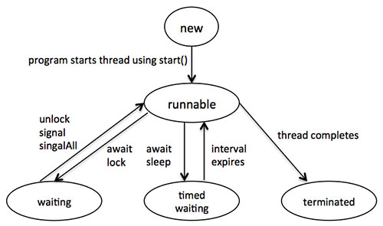
Life Cycle of a Thread
New: A new thread begins its life cycle in the new state. It remains in this state until the program starts the thread. It is also referred to as a born thread.
Runnable: After a newly born thread is started, the thread becomes runnable. A thread in this state is considered to be executing its task.
Waiting: Sometimes, a thread transitions to the waiting state while the thread waits for another thread to perform a task.A thread transitions back to the runnable state only when another thread signals the waiting thread to continue executing.
Timed waiting: A runnable thread can enter the timed waiting state for a specified interval of time. A thread in this state transitions back to the runnable state when that time interval expires or when the event it is waiting for occurs.
Terminated: A runnable thread enters the terminated state when it completes its task or otherwise terminates.

Slide 6
POSIX
POSIX stands for Portable Operating System Interface.
POSIX is a set of standard operating system interfaces based on the Unix operating system.
The need for standardization arose because enterprises using computers wanted to be able to develop programs that could be moved among different manufacturer's computer systems without having to be recoded. Unix was selected as the basis for a standard system interface partly because it was "manufacturer-neutral."

Slide 7
Pthreads & Threads in C++
POSIX threads are called as Pthreads.
Pthreads are defined as a set of C language programming types and procedure calls with a pthread.h header file.
#include<pthread.h> //header required for thread operations.
Compilation of C++ thread program can be done as:
g++ filename.c++ -lpthread
-lpthread command is used to indicate that you will link with the pthread library.

Slide 8
Identifiers in pthread library
Routine Prefix | Functional Group
pthread_ | Threads themselves and miscellaneous subroutines
pthread_attr_ | Thread attributes objects
pthread_mutex_ | Mutexes
pthread_mutexattr_ | Mutex attributes objects.
pthread_cond_ | Condition variables
pthread_condattr_ | Condition attributes objects
pthread_key_ | Thread-specific data keys
pthread_rwlock_ | Read/write locks
pthread_barrier_ | Synchronization barriers

Slide 9
Thread Creation
Synopsis:
int pthread_create(pthread_t *restrict thread, const pthread_attr_t *restrict attr, void *(*start_routine)(void*), void *restrict arg);
Pthread_create returns 0 if successful
pthread_create arguments:
thread: An opaque, unique identifier for the new thread returned by the subroutine.
attr: An opaque attribute object that may be used to set thread attributes. You can specify a thread attributes object, or NULL for the default values.
start_routine: the C routine that the thread will execute once it is created.
arg: A single argument that may be passed to start_routine. It must be passed by reference as a pointer cast of type void. NULL may be used if no argument is to be passed.

Slide 10
Thread termnation
void pthread_exit(void *value_ptr);
The pthread_exit() function shall terminate the calling thread and make the value value_ptr available to any successful join with the terminating thread.
Ex: pthread_exit(NULL);
Thread join
int pthread_join(pthread_t thread, void **value_ptr);
The pthread_join function is used to wait for termination of a thread - or wait for the thread to re-join the main thread.

Slide 11
Some other routines
pthread_cancel(thread):
The pthread_cancel() function shall request that thread be canceled. If successful it returns 0.
int pthread_attr_destroy(pthread_attr_t *attr) :
The pthread_attr_destroy() function shall destroy a thread attributes object.
int pthread_attr_init(pthread_attr_t *attr) :
The pthread_attr_init() function shall initialize a thread attributes object attr with the default value for all of the individual attributes

Slide 12
Example 1 : C++
#include<stdlib.h>
#include<pthread.h>
#include<iostream>
#include<unistd.h>
using namespace std;
void *print(void *threadid)
{
long tid=(long)threadid;
cout<<"\nProcess: "<<getpid()<<"Thread "<<pthread_self()<<" says: Hello";
pthread_exit(NULL);
}
int main()
{
pthread_t t[5];
int i,rc;
//creating 5 threads

Slide 13
for(i=0;i<5;i++)
{
cout<<"\nMessage : "<<i; sleep(1);
rc=pthread_create(&t[i],NULL,print,(void *)&i);
if(rc)
{
cout<<"\nUnable to create thread"<<endl;
exit(-1);
}
}
pthread_exit(NULL);
return 0;
}

Slide 14
Output :
kishan23fiba@ubuntu:~$ g++ pthread_helloworld.cpp -lpthread
kishan23fiba@ubuntu:~$ ./a.out
Message : 0
Message : 1
Process: 3848Thread 140376699467520 says: Hello
Message : 2
Process: 3848Thread 140376691074816 says: Hello
Message : 3
Process: 3848Thread 140376682682112 says: Hello
Message : 4
Process: 3848Thread 140376674289408 says: Hello
Process: 3848Thread 140376665896704 says: Hello

Slide 15
Example 2: C++
#include <iostream>
#include <cstdlib>
#include <pthread.h>
#include <unistd.h>
using namespace std;
#define NUM_THREADS 5
void *wait(void *t)
{
int i;
long tid;
tid = (long)t;
sleep(1);
cout << "Sleeping in thread " << endl;
cout << "Thread with id : " << pthread_self() << " ...exiting " << endl;
pthread_exit(NULL);
}

Slide 16
int main ()
{
int rc;
int i;
pthread_t threads[NUM_THREADS];
pthread_attr_t attr;
void *status;
// Initialize and set thread joinable
pthread_attr_init(&attr);
pthread_attr_setdetachstate(&attr, PTHREAD_CREATE_JOINABLE);
for( i=0; i < NUM_THREADS; i++ ){
cout << "main() : creating thread, " << i << endl;
rc = pthread_create(&threads[i], NULL, wait, (void *)&i );
if (rc){
cout << "Error:unable to create thread," << rc << endl;
exit(-1);
}
}
// free attribute and wait for the other threads
pthread_attr_destroy(&attr);
for( i=0; i < NUM_THREADS; i++ ){
rc = pthread_join(threads[i], &status);
if (rc){
cout << "Error:unable to join," << rc << endl;
exit(-1);
}
cout << "Main: completed thread id :" << i ;
cout << " exiting with status :" << status << endl;
}
cout << "Main: program exiting." << endl;
pthread_exit(NULL);
}

Slide 17
Output:
kishan23fiba@ubuntu:~$ g++ prog3.cpp -lpthread
kishan23fiba@ubuntu:~$ ./a.out
main() : creating thread, 0
main() : creating thread, 1
main() : creating thread, 2
main() : creating thread, 3
main() : creating thread, 4
Sleeping in thread
Thread with id : 140209435281152 ...exiting
Sleeping in thread
Thread with id : 140209426888448 ...exiting
Sleeping in thread
Thread with id : 140209443673856 ...exiting
Sleeping in thread
Thread with id : 140209452066560 ...exiting
Sleeping in thread
Thread with id : 140209460459264 ...exiting
Main: completed thread id :0 exiting with status :0
Main: completed thread id :1 exiting with status :0
Main: completed thread id :2 exiting with status :0
Main: completed thread id :3 exiting with status :0
Main: completed thread id :4 exiting with status :0
Main: program exiting.

Slide 18
Threads in C#
To use multithreading we have to use the Threading namespace which is included in System. The System.Threading namespace includes everything we need for multi threading.

Slide 19
Example 1
using System;
using System.Collections.Generic;
using System.Linq;
using System.Text;
using System.Threading;
namespace ParallelThreadsusingSleep
{
class ThreadClass
{
public static void function()
{
for(int i=0;i<10;i++)
{
Console.WriteLine("Hello : " + i);
Thread.Sleep(1);
}
}
}
class MainClass
{
public static void Main()
{
Thread t1 = new Thread(new ThreadStart(ThreadClass.function));
Thread t2 = new Thread(new ThreadStart(ThreadClass.function));
t1.Start();
t2.Start();
}
}
}

Slide 20
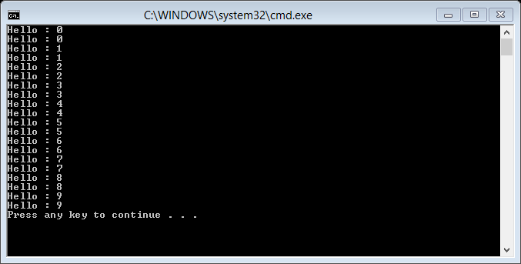
Output:

Slide 21
Example 2: Multithreaded Server
public Packets(PacketType type, string senderID)
{
Gdata = new List<string>();
this.senderID = senderID;
this.packetType = type;
}
public Packets(byte[] packetbytes)
{
BinaryFormatter bf=new BinaryFormatter();
MemoryStream ms=new MemoryStream(packetbytes);
Packets p = (Packets)bf.Deserialize(ms); //deserialize the byte array held in memory stream into packet
ms.Close();
this.Gdata = p.Gdata;
this.packetInt = p.packetInt;
this.packetBool = p.packetBool;
//Class Library
using System;
using System.Collections.Generic;
using System.Linq;
using System.Text;
using System.Threading.Tasks;
using System.IO;
using System.Runtime.Serialization.Formatters.Binary;
using System.Net;
namespace ServerData
{
[Serializable]
public class Packets
{
public List<string> Gdata;
public int packetInt;
public bool packetBool;
public String senderID;
public PacketType packetType;

Slide 22
this.senderID = p.senderID;
this.packetType = p.packetType;
}
public byte[] ToBytes()
{
BinaryFormatter bf = new BinaryFormatter();
MemoryStream ms = new MemoryStream();
bf.Serialize(ms, this); // this impleies the object we are contained in
byte[] bytes = ms.ToArray();
ms.Close();
return bytes;
}
public static string GetIP4Address()
{
IPAddress[] ips=Dns.GetHostAddresses(Dns.GetHostName());
foreach(IPAddress i in ips)
{
if (i.AddressFamily == System.Net.Sockets.AddressFamily.InterNetwork)
return i.ToString();
}
return "127.0.0.1";
}
}
public enum PacketType
{
Registration,
Chat
}
}

Slide 23
//Server
using System;
using System.Collections.Generic;
using System.Linq;
using System.Text;
using System.Threading.Tasks;
using ServerData;
using System.Net.Sockets;
using System.IO;
using System.Threading;
using System.Net;
namespace Server
{
class Server
{
static Socket listnerSocket;
static List<ClientData> _clients;
static void Main(string[] args)
{
Console.WriteLine("Starting server on " + Packets.GetIP4Address());
listnerSocket =new Socket(AddressFamily.InterNetwork,SocketType.Stream,ProtocolType.Tcp);

Slide 24
_clients = new List<ClientData>();
IPEndPoint ip = new IPEndPoint(IPAddress.Parse(Packets.GetIP4Address()), 4242);
listnerSocket.Bind(ip);
Thread listenThread = new Thread(ListenThread);
listenThread.Start();
} // start server
// we need
// listener - listens for clients trying to connect
static void ListenThread()
{
for (; ; )
{
listnerSocket.Listen(0);
_clients.Add(new ClientData(listnerSocket.Accept()));
}
}
//clinetdatathread - recieves data from each client individually
public static void Data_IN(object cSocket)
{
Socket clientSocket = (Socket)cSocket;
byte[] Buffer;
int readBytes;
for(; ;)
{
try
{
Buffer = new byte[clientSocket.SendBufferSize];
readBytes = clientSocket.Receive(Buffer);
if (readBytes > 0)
{
//handle the read data
Packets packet = new Packets(Buffer);
DataManager(packet);
}
}

Slide 25
catch(SocketException ex)
{
Console.WriteLine(" A client disconnected");
}
}
}
//data manager
public static void DataManager(Packets p)
{
switch(p.packetType)
{
case PacketType.Chat:
foreach(ClientData c in _clients)
{
c.clientSocket.Send(p.ToBytes());
}
break;
}
} }
class ClientData
{
public Socket clientSocket;
public Thread clientThread;
public string id;
public ClientData()
{
id = Guid.NewGuid().ToString();
clientThread = new Thread(Server.Data_IN);
clientThread.Start(clientSocket);
SendRegsitrationPacket();
}
public ClientData(Socket clientSocket)
{
this.clientSocket = clientSocket;
id = Guid.NewGuid().ToString();
clientThread = new Thread(Server.Data_IN);
clientThread.Start(clientSocket);
SendRegsitrationPacket();
}

Slide 26
public void SendRegsitrationPacket()
{
Packets p = new Packets(PacketType.Registration,"server");
p.Gdata.Add(id);
clientSocket.Send(p.ToBytes());
}
}
}

Slide 27
//Client
using System;
using System.Collections.Generic;
using System.Linq;
using System.Text;
using System.Threading.Tasks;
using ServerData;
using System.IO;
using System.Net;
using System.Net.Sockets;
using System.Threading;
namespace Client
{
class Client
{
//similar to server except it doesnt listens to clients
public static Socket master; //mastersocket
public static string name;
public static string id;
static void Main(string[] args)
{
Console.Write("Enter your Name: ");
name = Console.ReadLine();
A: Console.Clear();
Console.WriteLine("ENter host IP Address: ");
String ip = Console.ReadLine();
master = new Socket(AddressFamily.InterNetwork, SocketType.Stream, ProtocolType.Tcp);
IPEndPoint ipe = new IPEndPoint(IPAddress.Parse(ip), 4242);
try
{
master.Connect(ipe);
}
catch
{
Console.WriteLine("Could not connect to the host");
Thread.Sleep(1000);
goto A;
}
Thread t = new Thread(Data_IN);
t.Start();

Slide 28
for(;;)
{
Console.Write(">");
String input = Console.ReadLine();
Packets p = new Packets(PacketType.Chat,id);
p.Gdata.Add(name);
p.Gdata.Add(input);
master.Send(p.ToBytes());
}
}
// need a data listener
static void Data_IN()
{
byte[] Buffer;
int readBytes;
for(;;)
{
try
{
Buffer = new byte[master.SendBufferSize];
readBytes = master.Receive(Buffer);
if (readBytes > 0)
{
DataManager(new Packets(Buffer));
}
}
catch(SocketException ex)
{
Console.WriteLine("Server disconnected");
Console.ReadLine();
Environment.Exit(0);
}
}
}
static void DataManager(Packets p)
{
switch(p.packetType)
{
case PacketType.Registration: id = p.Gdata[0];
break;
case PacketType.Chat: Console.WriteLine(p.Gdata[0] + " : " + p.Gdata[1]);
break;
} } } }

Slide 29
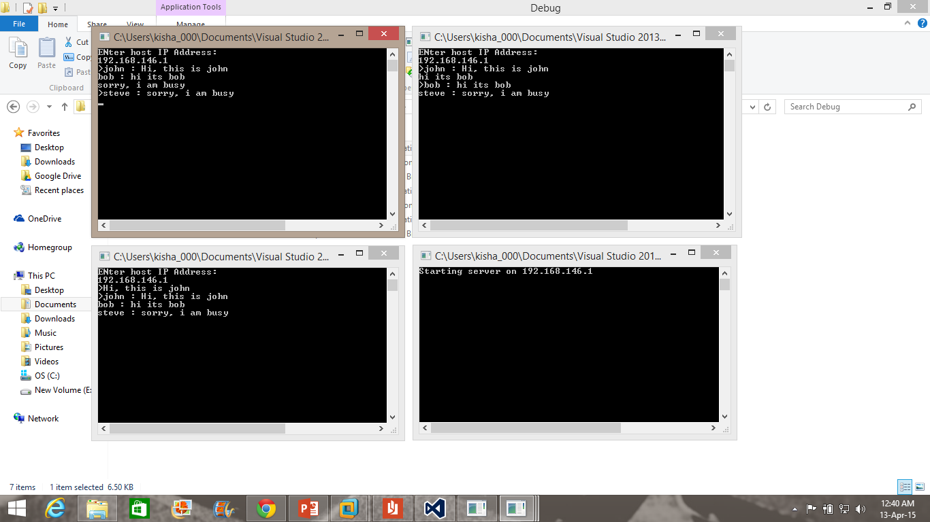

Slide 30
Thread in Java

Slide 31
Thread Libraries
Thread Creation with two ways:
By extending Thread class
By implementing Runnable interface

Slide 32
By extending Thread class
class Multi extends Thread{
public void run(){
System.out.println("thread is running...");
}
public static void main(String args[]){
Multi t1=new Multi();
t1.start();
}
}
Output:thread is running...

Slide 33
By implementing the Runnable interface
class Multi implements Runnable{
public void run(){
System.out.println("thread is running...");
}
public static void main(String args[]){
Multi m1=new Multi();
Thread t1 =new Thread(m1);
t1.start();
}
}
Output:thread is running...

Slide 34
Multithreading
Multithreading in java is a process of executing multiple threads simultaneously.
We use multithreading instead of multiprocessing because threads share a common memory area. They don't allocate separate memory area so saves memory, and context-switching between the threads takes less time than process.

Slide 35
Multithreading
Benefits:
Improve application responsiveness.
User of multithreaded GUI don’t have to wait for one activity to complete.
Use multiprocessors more efficiently.
Improve program structure.
Use fewer system resources.

Slide 36
class PrintDemo {
public void printCount(){
try {
for(int i = 5; i > 0; i--) {
System.out.println("Counter --- " + i );
Thread.sleep(500);
}
} catch (Exception e) {
System.out.println("Thread interrupted.");
}
}
}
class ThreadDemo extends Thread {
private Thread t;
private String threadName;
PrintDemo PD;
ThreadDemo( String name, PrintDemo pd){
threadName = name;
PD = pd;
}
public void run() {
synchronized(PD){
PD.printCount();
}
System.out.println("Thread " + threadName + " exiting.");
}
public void start ()
{
System.out.println("Starting " + threadName );
if (t == null)
{
t = new Thread (this, threadName);
t.start ();
}
}
}

Slide 37
public class test {
public static void main(String args[]) {
PrintDemo PD = new PrintDemo();
ThreadDemo T1 = new ThreadDemo( "Thread - 1 ", PD );
ThreadDemo T2 = new ThreadDemo( "Thread - 2 ", PD );
T1.start();
T2.start();
}
}
Starting Thread - 1
Starting Thread - 2
Counter --- 5
Counter --- 4
Counter --- 3
Counter --- 2
Counter --- 1
Thread Thread - 1 exiting.
Counter --- 5
Counter --- 4
Counter --- 3
Counter --- 2
Counter --- 1
Thread Thread - 2 exiting.

Slide 38
class Customer {
int amount = 10000;
synchronized void withdraw(int amount) {
System.out.println("current balance is " + this.amount);
System.out.println("going to withdraw "+ amount);
if (this.amount < amount) {
System.out.println("Less balance, cannot withdraw "+ amount+ ", waiting for deposit...");
try {
wait();
} catch (Exception e) {
}
}
this.amount -= amount;
System.out.println("current balance is " + this.amount);
System.out.println("withdraw completed...");
}
synchronized void deposit(int amount) {
System.out.println("going to deposit " + amount);
this.amount += amount;
System.out.println("current balance is " + this.amount);
System.out.println("deposit completed... ");
notify();
}
}

Slide 39
class Test {
public static void main(String args[]) {
final Customer c = new Customer();
new Thread() {
public void run() {
c.withdraw(15000);
}
}.start();
new Thread() {
public void run() {
c.deposit(10020);
}
}.start();
}
}
current balance is 10000
going to withdraw 15000
Less balance, cannot withdraw 15000, waiting for deposit...
going to deposit 10020
current balance is 20020
deposit completed...
current balance is 5020
withdraw completed...

Slide 40
Thread in Java

Slide 41
No Mutext
package withoutmutex;
class Counter{
long count = 0;
public void sort(String threadname)
{
int intArray[] = new int[]{7,90,35,45,150,13,17,42,91,33};
System.out.println(threadname);
//print array before sorting using bubble sort algorithm
System.out.println("Array Before Bubble Sort");
for(int i=0; i < intArray.length; i++){
System.out.print(intArray[i] + " ");
}
System.out.println();
int n = intArray.length;
int temp = 0;
for(int i=0; i < n; i++)
{
for(int j=1; j < (n-i); j++)
{
if(intArray[j-1] > intArray[j])
{
//swap the elements!
temp = intArray[j-1];
intArray[j-1] = intArray[j];
intArray[j] = temp;
}
}
}
System.out.println("Array after Bubble Sort");
for(int i=0; i < intArray.length; i++)
{
System.out.print(intArray[i] + " ");
}
System.out.println();
this.count = intArray[0];
System.out.println("the minimum value is: (start of count) " + count);
}
public void add(String threadname)
{
System.out.println(threadname);
System.out.println("the count before add 1 for 100 times is: " + count);
for (int i=0;i<100;i++)
{
this.count++;
System.out.println("count is " +count);
}
}
public void mul(String threadname)
{
System.out.println(threadname);
System.out.println("the count before mul 2 for 10 times is: " + count);
for (int i=0;i<10;i++)
{
this.count *=2;
System.out.println("count is " +count);
}
}
}
class add10 extends Thread{
protected Counter counter = null;
String threadname;
public add10(Counter counter,String threadname){
this.counter = counter;
this.threadname= threadname;
}
public void run()
{
counter.add(threadname);
}
}
class mul2 extends Thread{
protected Counter counter = null;
String threadname;
public mul2(Counter counter,String threadname){
this.counter = counter;
this.threadname= threadname;
}
public void run()
{
counter.mul(threadname);
}
}
class bubblesort extends Thread{
protected Counter counter = null;
String threadname;
public bubblesort(Counter counter,String threadname){
this.counter = counter;
this.threadname= threadname;
}
public void run()
{
counter.sort(threadname);
}
}
public class nomutex {
public static void main(String[] args) throws InterruptedException
{
Counter counter = new Counter();
Thread thread0 = new bubblesort(counter,"thread-0");
Thread threadA = new add10(counter, "thread-A");
Thread threadB = new mul2(counter, "thread-B");
thread0.start();
Thread.sleep(1);
System.out.println("tharead A wake up");
threadA.start();
Thread.sleep(100);
System.out.println("tharead B wake up");
threadB.start();
}
}

Slide 42
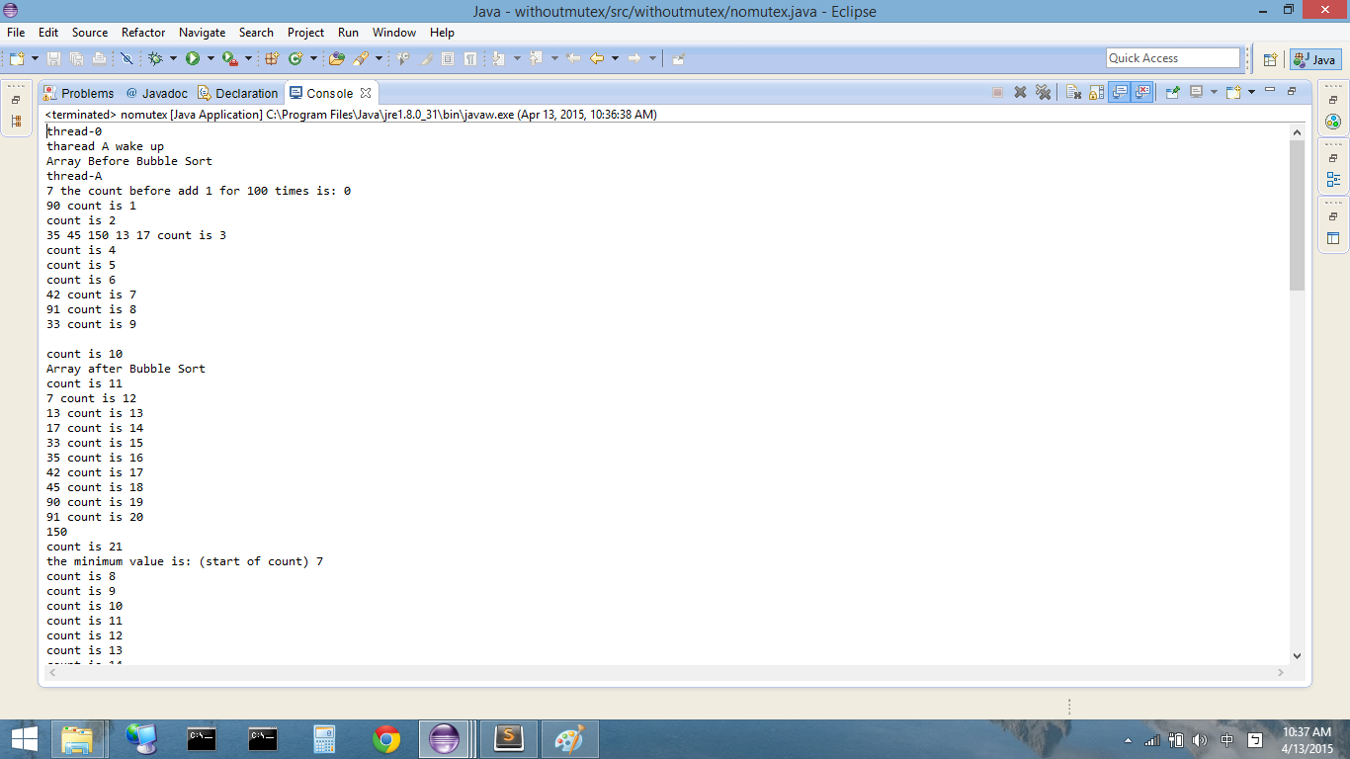
No Mutext Output 1

Slide 43
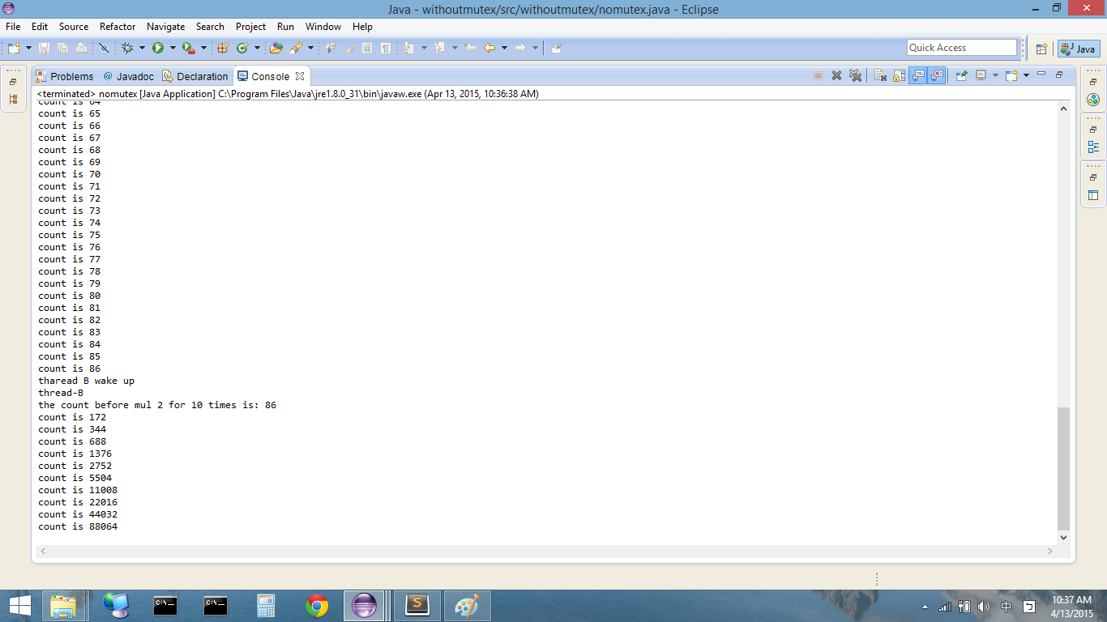
No Mutext Output 2

Slide 44
No Mutext Output 3

Slide 45
Mutex
package mutex2;
class Counter{
long count = 0;
public synchronized void sort(String threadname)
{
int intArray[] = new int[]{7,90,35,45,150,13,17,42,91,33};
System.out.println(threadname);
//print array before sorting using bubble sort algorithm
System.out.println("Array Before Bubble Sort");
for(int i=0; i < intArray.length; i++){
System.out.print(intArray[i] + " ");
}
System.out.println();
int n = intArray.length;
int temp = 0;
for(int i=0; i < n; i++)
{
for(int j=1; j < (n-i); j++)
{
if(intArray[j-1] > intArray[j])
{
//swap the elements!
temp = intArray[j-1];
intArray[j-1] = intArray[j];
intArray[j] = temp;
}
}
}
System.out.println("Array after Bubble Sort");
for(int i=0; i < intArray.length; i++)
{
System.out.print(intArray[i] + " ");
}
System.out.println();
this.count = intArray[0];
System.out.println("the minimum value is: (start of count) " + count);
}
public synchronized void add(String threadname)
{
System.out.println(threadname);
System.out.println("the count before add 1 for 100 times is: " + count);
for (int i=0;i<100;i++)
{
this.count++;
System.out.println("count is " +count);
}
}
public synchronized void mul(String threadname)
{
System.out.println(threadname);
System.out.println("the count before mul 2 for 10 times is: " + count);
for (int i=0;i<10;i++)
{
this.count *=2;
System.out.println("count is " +count);
}
}
}
class add10 extends Thread{
protected Counter counter = null;
String threadname;
public add10(Counter counter,String threadname){
this.counter = counter;
this.threadname= threadname;
}
public void run()
{
counter.add(threadname);
}
}
class mul2 extends Thread{
protected Counter counter = null;
String threadname;
public mul2(Counter counter,String threadname){
this.counter = counter;
this.threadname= threadname;
}
public void run()
{
counter.mul(threadname);
}
}
class bubblesort extends Thread{
protected Counter counter = null;
String threadname;
public bubblesort(Counter counter,String threadname){
this.counter = counter;
this.threadname= threadname;
}
public void run()
{
counter.sort(threadname);
}
}
public class mutex2 {
public static void main(String[] args) throws InterruptedException
{
Counter counter = new Counter();
Thread thread0 = new bubblesort(counter,"thread-0");
Thread threadA = new add10(counter, "thread-A");
Thread threadB = new mul2(counter, "thread-B");
thread0.start();
Thread.sleep(1);
System.out.println("tharead A wake up");
threadA.start();
Thread.sleep(100);
System.out.println("tharead B wake up");
threadB.start();
}
}

Slide 46
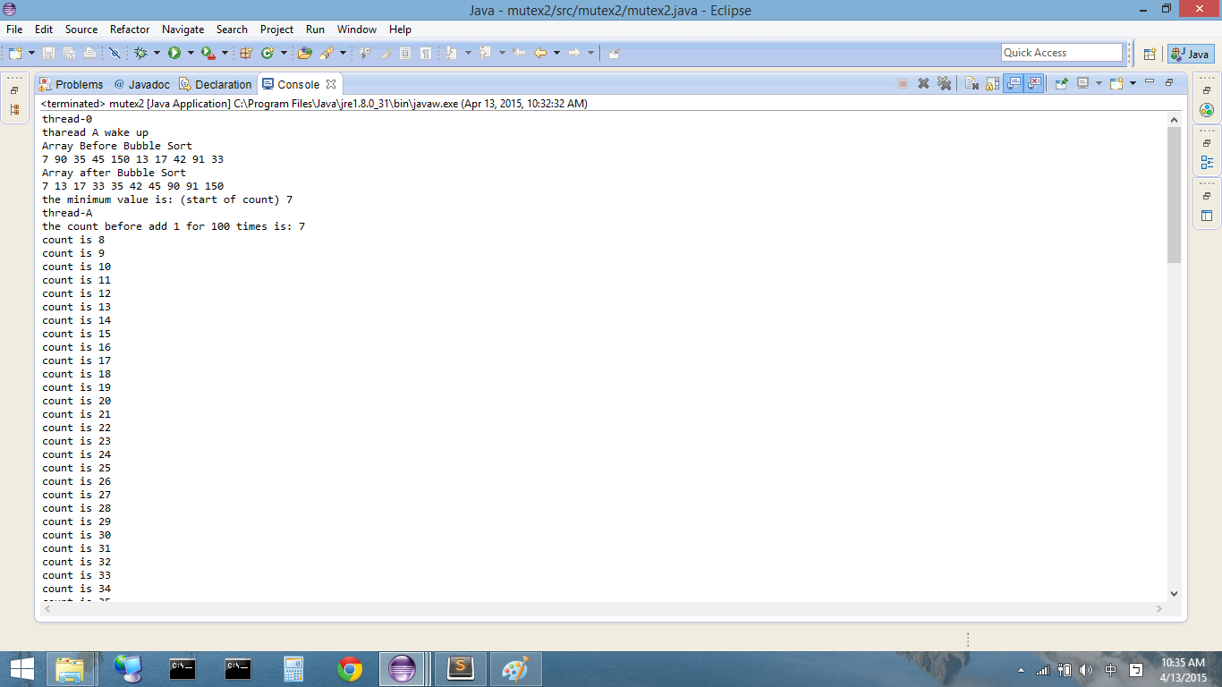
Mutex Output 1

Slide 47

Mutex Output 1

Slide 48
Server
package server;
import java.io.IOException;
import java.io.PrintWriter;
import java.net.ServerSocket;
import java.net.Socket;
import java.util.Date;
import java.util.Vector;
import java.net.*;
import java.io.*;
import java.util.*;
import java.net.Socket;
class ClientInfo
{
public Socket mSocket = null;
public ClientListener mClientListener = null;
public ClientSender mClientSender = null;
}
class ClientSender extends Thread
{
private Vector mMessageQueue = new Vector();
private ServerDispatcher mServerDispatcher;
private ClientInfo mClientInfo;
private PrintWriter mOut;
public ClientSender(ClientInfo aClientInfo, ServerDispatcher aServerDispatcher)
throws IOException
{
mClientInfo = aClientInfo;
mServerDispatcher = aServerDispatcher;
Socket socket = aClientInfo.mSocket;
mOut = new PrintWriter(new OutputStreamWriter(socket.getOutputStream()));
}
public synchronized void sendMessage(String aMessage)
{
mMessageQueue.add(aMessage);
notify();
}
private synchronized String getNextMessageFromQueue() throws InterruptedException
{
while (mMessageQueue.size()==0)
wait();
String message = (String) mMessageQueue.get(0);
mMessageQueue.removeElementAt(0);
return message;
}
private void sendMessageToClient(String aMessage)
{
mOut.println(aMessage);
mOut.flush();
}
public void run()
{
try {
while (!isInterrupted()) {
String message = getNextMessageFromQueue();
sendMessageToClient(message);
}
} catch (Exception e)
{
}
mClientInfo.mClientListener.interrupt();
mServerDispatcher.deleteClient(mClientInfo);
}
}
class ClientListener extends Thread
{
private ServerDispatcher mServerDispatcher;
private ClientInfo mClientInfo;
private BufferedReader mIn;
public ClientListener(ClientInfo aClientInfo, ServerDispatcher aServerDispatcher)
throws IOException
{
mClientInfo = aClientInfo;
mServerDispatcher = aServerDispatcher;
Socket socket = aClientInfo.mSocket;
mIn = new BufferedReader(new InputStreamReader(socket.getInputStream()));
}
public void run()
{
try {
while (!isInterrupted()) {
String message = mIn.readLine();
if (message == null)
break;
mServerDispatcher.dispatchMessage(mClientInfo, message);
}
} catch (IOException ioex) {
}
mClientInfo.mClientSender.interrupt();
mServerDispatcher.deleteClient(mClientInfo);
}
}
class ServerDispatcher extends Thread
{
private Vector mMessageQueue = new Vector();
private Vector mClients = new Vector();
public synchronized void addClient(ClientInfo aClientInfo)
{
mClients.add(aClientInfo);
}
public synchronized void deleteClient(ClientInfo aClientInfo)
{
int clientIndex = mClients.indexOf(aClientInfo);
if (clientIndex != -1)
mClients.removeElementAt(clientIndex);
}
public synchronized void dispatchMessage(ClientInfo aClientInfo, String aMessage)
{
Socket socket = aClientInfo.mSocket;
String senderIP = socket.getInetAddress().getHostAddress();
String senderPort = "" + socket.getPort();
aMessage = senderIP + ":" + senderPort + " : " + aMessage;
mMessageQueue.add(aMessage);
notify();
}
private synchronized String getNextMessageFromQueue()
throws InterruptedException
{
while (mMessageQueue.size()==0)
wait();
String message = (String) mMessageQueue.get(0);
mMessageQueue.removeElementAt(0);
return message;
}
private synchronized void sendMessageToAllClients(String aMessage)
{
for (int i=0; i<mClients.size(); i++) {
ClientInfo clientInfo = (ClientInfo) mClients.get(i);
clientInfo.mClientSender.sendMessage(aMessage);
}
}
public void run()
{
try {
while (true) {
String message = getNextMessageFromQueue();
sendMessageToAllClients(message);
}
} catch (InterruptedException ie) {
}
}
}
public class server
{
public static final int LISTENING_PORT = 2002;
@SuppressWarnings("resource")
public static void main(String[] args)
{
// Open server socket for listening
ServerSocket serverSocket = null;
try {
serverSocket = new ServerSocket(LISTENING_PORT);
System.out.println("Server started on port " + LISTENING_PORT);
} catch (IOException se) {
System.err.println("Can not start listening on port " + LISTENING_PORT);
se.printStackTrace();
System.exit(-1);
}
ServerDispatcher serverDispatcher = new ServerDispatcher();
serverDispatcher.start();
while (true) {
try {
Socket socket = serverSocket.accept();
ClientInfo clientInfo = new ClientInfo();
clientInfo.mSocket = socket;
ClientListener clientListener =
new ClientListener(clientInfo, serverDispatcher);
ClientSender clientSender =
new ClientSender(clientInfo, serverDispatcher);
clientInfo.mClientListener = clientListener;
clientInfo.mClientSender = clientSender;
clientListener.start();
clientSender.start();
serverDispatcher.addClient(clientInfo);
} catch (IOException ioe) {
ioe.printStackTrace();
}
}
}
}

Slide 49
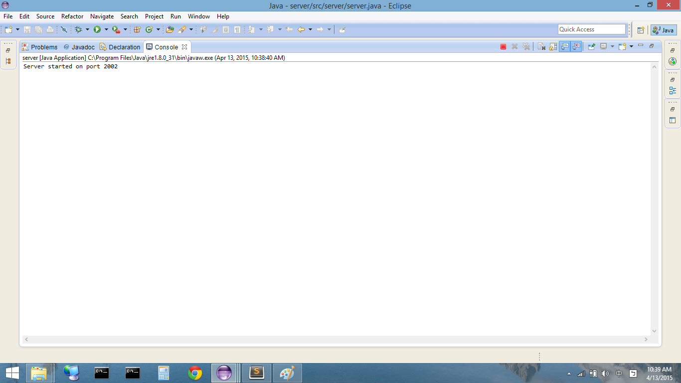
Server

Slide 50
Client1
package client;
import java.io.*;
import java.net.*;
public class client
{
public static final String SERVER_HOSTNAME = "localhost";
public static final int SERVER_PORT = 2002;
public static void main(String[] args)
{
BufferedReader in = null;
PrintWriter out = null;
try {
Socket socket = new Socket(SERVER_HOSTNAME, SERVER_PORT);
in = new BufferedReader(
new InputStreamReader(socket.getInputStream()));
out = new PrintWriter(
new OutputStreamWriter(socket.getOutputStream()));
System.out.println("Connected to server " +
SERVER_HOSTNAME + ":" + SERVER_PORT);
} catch (IOException ioe) {
System.err.println("Can not establish connection to " +
SERVER_HOSTNAME + ":" + SERVER_PORT);
ioe.printStackTrace();
System.exit(-1);
}
Sender sender = new Sender(out);
sender.setDaemon(true);
sender.start();
try {
String message;
while ((message=in.readLine()) != null) {
System.out.println(message);
}
} catch (IOException ioe) {
System.err.println("Connection to server broken.");
ioe.printStackTrace();
}
}
}
class Sender extends Thread
{
private PrintWriter mOut;
public Sender(PrintWriter aOut)
{
mOut = aOut;
}
public void run()
{
try {
BufferedReader in = new BufferedReader(new InputStreamReader(System.in));
while (!isInterrupted()) {
String message = in.readLine();
mOut.println(message);
mOut.flush();
}
} catch (IOException ioe) {
}
}
}

Slide 51
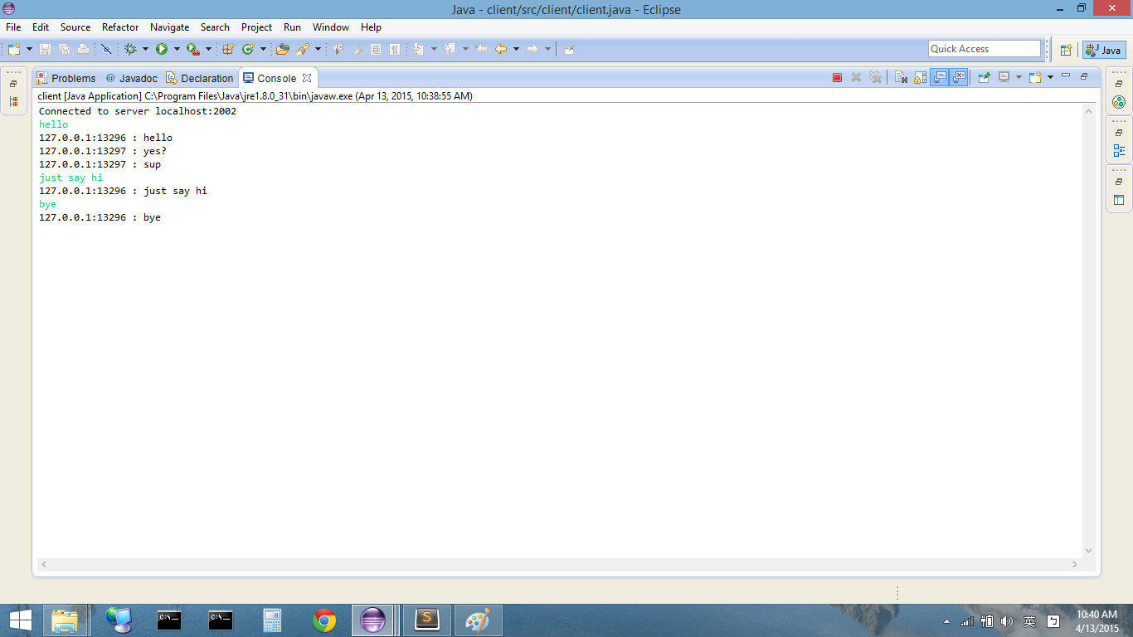
Client1

Slide 52
Client 2
package client;
import java.io.*;
import java.net.*;
public class client2
{
public static final String SERVER_HOSTNAME = "localhost";
public static final int SERVER_PORT = 2002;
public static void main(String[] args)
{
BufferedReader in = null;
PrintWriter out = null;
try {
Socket socket = new Socket(SERVER_HOSTNAME, SERVER_PORT);
in = new BufferedReader(
new InputStreamReader(socket.getInputStream()));
out = new PrintWriter(
new OutputStreamWriter(socket.getOutputStream()));
System.out.println("Connected to server " +
SERVER_HOSTNAME + ":" + SERVER_PORT);
} catch (IOException ioe) {
System.err.println("Can not establish connection to " +
SERVER_HOSTNAME + ":" + SERVER_PORT);
ioe.printStackTrace();
System.exit(-1);
}
Sender sender = new Sender(out);
sender.setDaemon(true);
sender.start();
try {
String message;
while ((message=in.readLine()) != null) {
System.out.println(message);
}
} catch (IOException ioe) {
System.err.println("Connection to server broken.");
ioe.printStackTrace();
}
}
}
class Sender extends Thread
{
private PrintWriter mOut;
public Sender(PrintWriter aOut)
{
mOut = aOut;
}
public void run()
{
try {
BufferedReader in = new BufferedReader(new InputStreamReader(System.in));
while (!isInterrupted()) {
String message = in.readLine();
mOut.println(message);
mOut.flush();
}
} catch (IOException ioe) {
}
}
}

Slide 53
Client2

Slide 54
Thread in C#
Name: Qiao Ma

Slide 55
Introduction
Basic syntax
Blocking application
Thread non-blocking application
Multi-threading application (Chat room)

Slide 56
Basic Syntax
In .Net, all the threading related classes are presented in System.Threading namespace.
using System.Threading;

Slide 57
Create Thread
Choose one:
Thread thread = new Thread(delegate() { DoThreadTask(); });
Thread thread = new Thread(() => DoThreadTask());
Thread thread = new Thread(DoThreadTask);
thread.Start();
Private void DoThreadTask(){
//task…
}

Slide 58
Advantage of Thread
The program is responsive even there is long time task.
Long time task such as waiting input/output can be done in one thread.
The main thread is still responsive

Slide 59
Blocking Demo

Slide 60
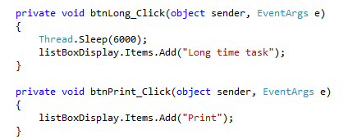
Blocking App

Slide 61
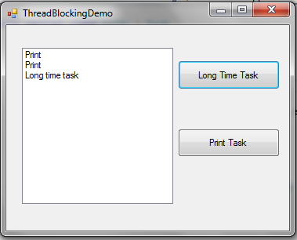
Output
After click Long Time Task button, the program is not responsive until that long time task finish.

Slide 62
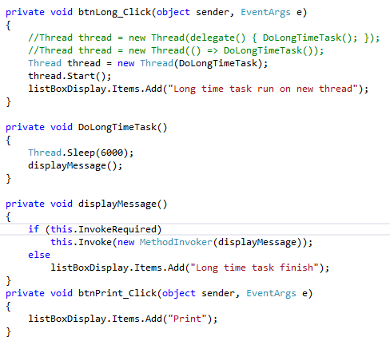
Non-Blocking App

Slide 63
Output
Program is still responsive after Long Time Task button click

Slide 64
Multi-Threading App (Chat Room)
Notes:
The basic idea is, whenever the Server gets a connection request from Client, the Server creates a separate Client Thread in Server side for communicate with that particular Client Socket. That means, for each Client Socket there is a separate Client Thread in Server side for independent communication. So the Client can communicate independently with their own Client Thread in the Server side.

Slide 65
Chat Room Demo

Slide 66
Client (1)

Slide 67
Client (2)

Slide 68
Server (1)

Slide 69
Server(2)

Slide 70
Server (3)

Slide 71
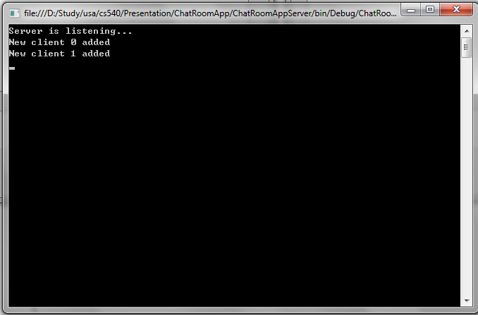
Output (Server)

Slide 72
Output (Client)

Slide 73
Thank you very much!

